Slide 1
Personalised Care: how Prehab/Rehab fits with existing delivery
Zoe Merchant – Programme Lead for Prehab4Cancer/Specialist Occupational Therapist
GM Cancer
@ZoeMerchantOT www.prehab4cancer.co.uk @Prehab4Cancer

Slide 2
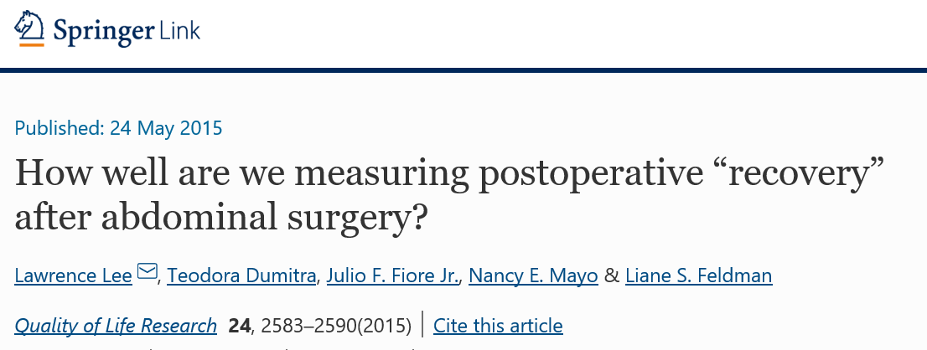
Priorities identified by patients:
Energy Level
Sensation of Pain
General Physical Endurance
Carrying out daily routine
WHO International Classification of Function, Disability and Health

Slide 3
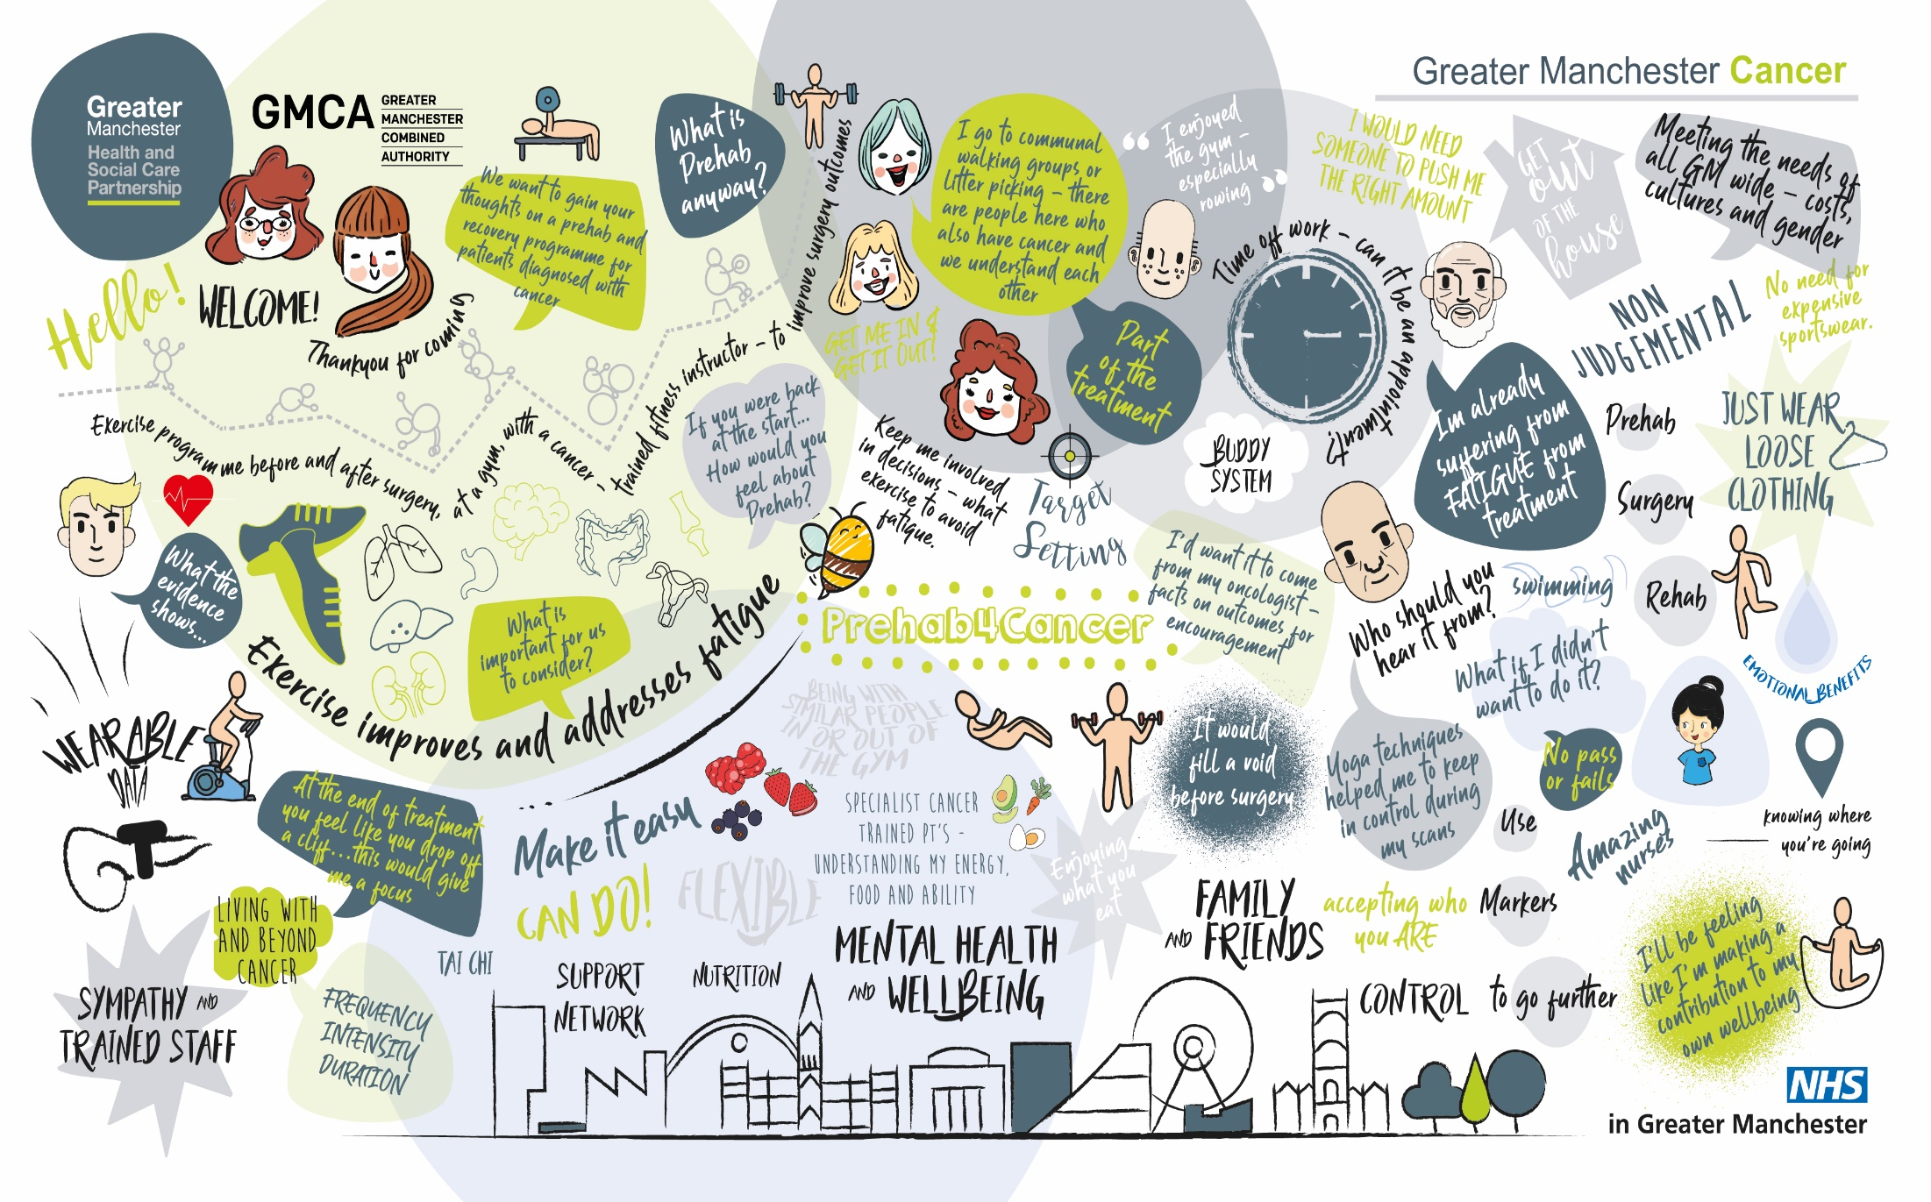
Notes:
User Involvement CRITICAL:
Focus group already completed,
PABC to be integral to programme governance: steering groups and implementation,
Need to engage ‘harder to reach groups’ – deprivation, people from diverse ethnic backgrounds. GM & East Cheshire – wide ranging in culture, backgrounds and wealth.
SALIENT POINTS FROM THIS GROUP:
Consistent info – from oncologist/surgeon – part of treatment – need an appt letter,
Falling off a cliff
CONTROL
Fatigue
Therapeutic rapport – people involved
Personalised care!!

Slide 4
How Prehab/Rehab enables Personalised Care to be delivered… Self-Management Patient Empowerment Taking Control

Slide 6
PREHAB INTERVENTION
Universal Targeted Model = NHSE Personalised Care Model
Specialised
Targeted
Universal
COST
SUPERVISION
LOCATION

Slide 7
Stepped Care Model (NICE 2004)
WHO?
Prehab Workforce incl. Exercise Specialists
MDT incl. CNSs &AHPs
Macmillan Information and Support
Psychology/IAPT
Primary Care incl. Social Prescribing

Slide 8
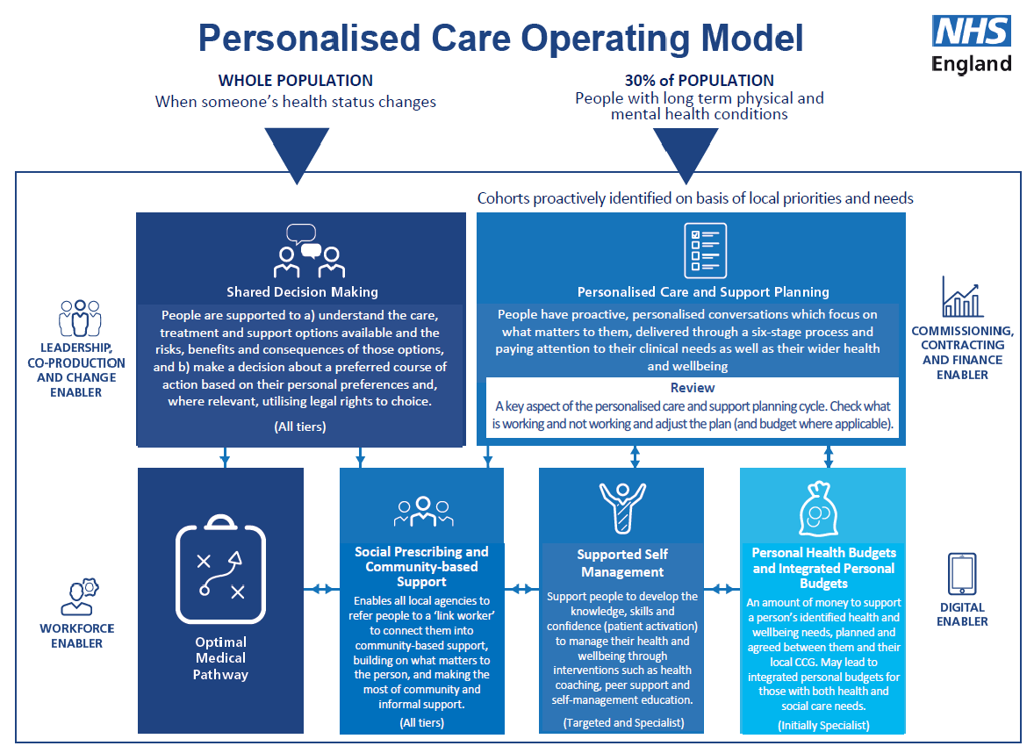

Slide 9
Personalised Care Interventions
Personalised Care and Support Plan based on HNA
Ensures people’s physical, practical, emotional, social needs are met and that resources are targeted to those who need them most.
End of Treatment Summary
Completed by secondary care and given to the patient and GP. Provides detailed summary of treatment, potential side effects, signs and symptoms of recurrence and contact details to address any concerns.
Health & Wellbeing Information & Support
Information and support to patients/their family before, during and after cancer treatment. This may include: how to support management of side effects, community support groups, financial support, how to get back to work, diet and lifestyle.
Cancer Care Review
Discussion between patient and GP / Nurse about their cancer journey. Helps patient understand what information and support is available.

Slide 10
Jane: example Concerns Checklist
Holistic Needs Assessment
Notes:
This is an example

Slide 11
Assessment Clinic Overview
Referral
Portal
48 Hr Contact
Baseline
Assessment
4 working days
Post
Chemo
Upper GI only
Pre-Op
Assessment
Within 5 days
Post-Op
Assessment
6,8,12 weeks
End of
Rehab
12 Week intervention
Functional Capacity
ISWT or 6 Min Walk
Hand Grip Dynamometry
1 Minute Sit to stand
PROMS
EQ5D-5L
IPAQ
Self Efficacy Scale
Rockwood Frailty
WHODAS 2.0
EORTCQLQ-C30
Health checks
PG-SGA
Blood pressure
Height
Weight
Resting HR
Oxygen stats

Slide 12
Notes:
Patient focus groups GM – Prehab/Rehab addresses personalised care needs

Slide 13
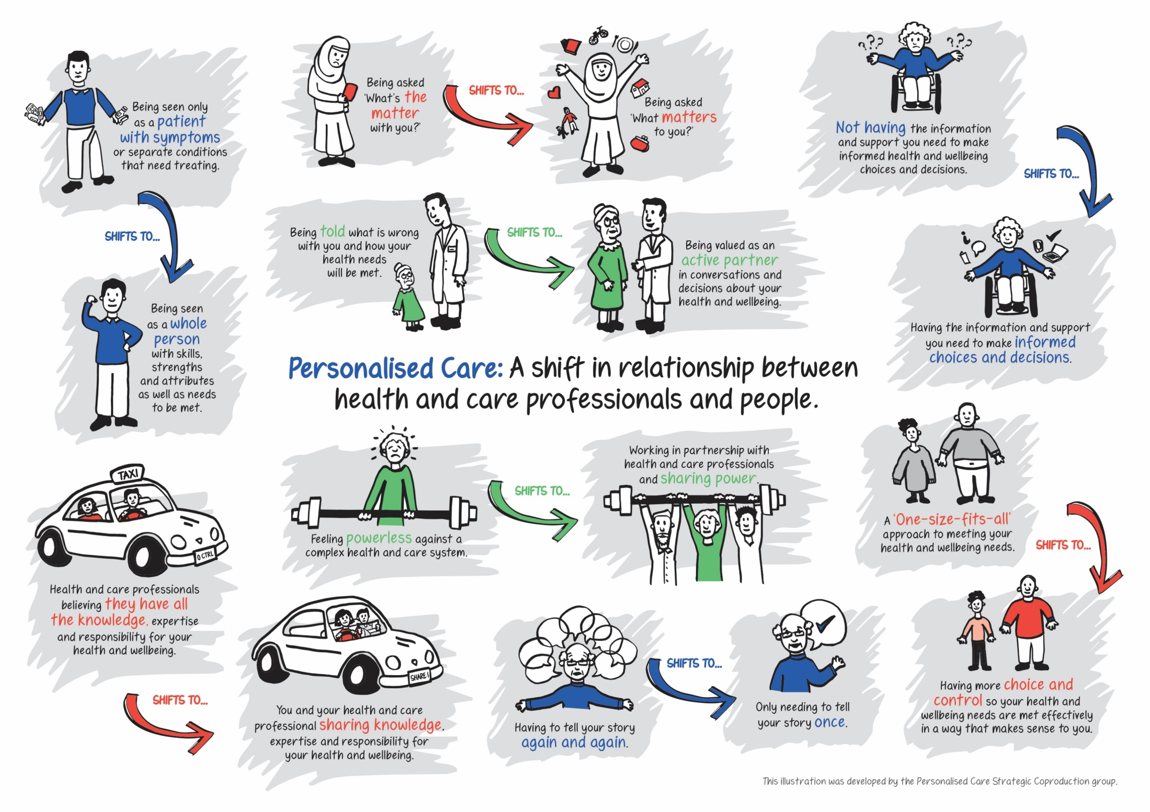
Questions?

