Slide 1
TONY COLLIER BEM
PREHAB4CANCER, A PATIENT REPRESENTATIVE VIEW

Slide 2
My Story
Life changing event aged 45
Diet
Alcohol
Exercise
Running
Marathons
Ultra marathon
Running Into Cancer
Diagnosis
Prognosis
Impact

Slide 3
My Story
Choices post diagnosis
2 ways forward
Side effects of treatment
Loss of muscle mass
Weight gain
Hot flushes
Hot sweats
Fatigue
Mental health
Impact on exercise
Exercise a vital part of maintaining my physical and mental well being

Slide 4
Prehab4Cancer
Patient Representative
Why?
Control
What can we offer/what do we do?
Shaping P4C to date (eg document reviews)
Providing professionals with a patients eye view
Sanity check (early example – “You might even enjoy it”)
Attending Steering Group Meetings
Focus groups (greater acceptance of PR?)
Website reviews www.prehab4cancer.co.uk
Enhance design and delivery
Shaping P4C into the future

Slide 5
Prehab4Cancer – If Exercise Were a Pill We’d All Be Taking It
Exercise is vital for physical and mental well being
Prehab4Cancer fantastic opportunity to improve lives of people diagnosed with cancer
Fantastic patient feed back
Keen to see expansion of programme to other tumour groups ASAP

Slide 7
5K Your Way
A community-based initiative to encourage those living with and beyond cancer, families, friends and those working in cancer services to walk, jog, run, cheer or volunteer at a local 5K Your Way parkrun event on the last Saturday of every month.

Slide 8
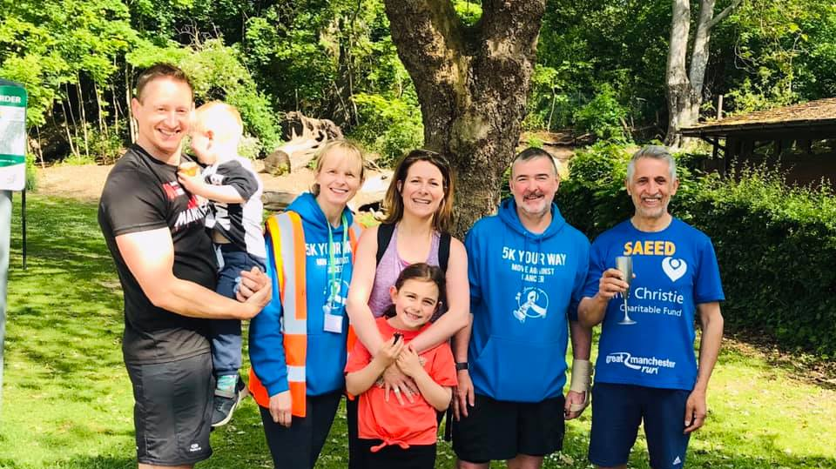

Slide 9
What 5KYW is:
A support group with a difference
A run and walking club with a difference
A social opportunity with a difference
A coffee morning with a difference
Founded by Lucy Gossage, Gemma Hillier-Moses and MOVE Charity

Slide 10
Matthew Evison
“Loved walking with my lad @cancer5kYourWay today. Jacob had leukaemia aged 4 months old & will need to learn the value of exercise in combatting long term effects of chemotherapy.”
“5KYW is fast becoming a very special event for us Evisons! A chance for me & Jacob to spend one on one time together playing silly games. A time to reflect on his illness, his recovery & the importance of #physicalactivity for him as he grows up.”
“Your hard work is helping those affected by cancer and it’s inspiring to see. The impact of this across the country is huge!”

Slide 11
Conclusion
Significant evidence that exercise, both prehab and rehab, produces substantial benefits in terms of physical and mental well being for all tumour groups.
Prehab4Cancer now offered throughout GM at diagnosis and impacting positively on peoples lives.
Parkrun GP prescribing growing massively with over 1300 GP practices referring patients to parkrun.
5KYW offers a natural extension to cancer rehab encouraging maintenance of exercise as well as social interaction and mutually supporting each other.

Slide 12
QUESTIONS

